Slide 1
Lecture 11
Exploratory Data Analysis (cont’d)
Variation and Covariation
Categorical and Numerical Data

Slide 2
Variation and Covariation
Variation
- is the tendency of the values of a variable to change from measurement to measurement.
- variation describes behavior within the data
Covariation
- is the tendency for the values of two or more variables to vary together in a related way.
- covariation describes behavior between two or more datasets.
- the best way to spot covariation is to visualize the relationship between two or more variables.

Slide 3
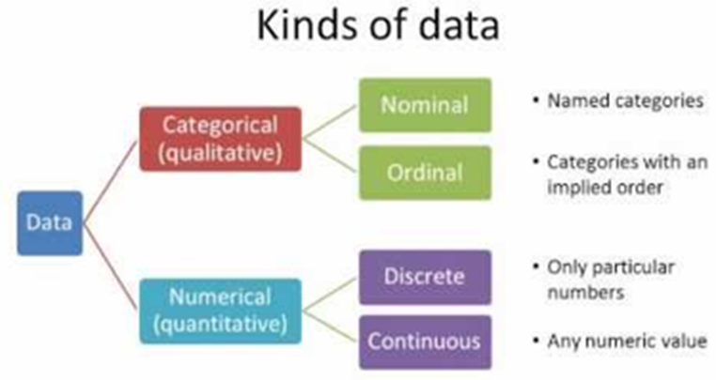
Categorical and Numerical Data

Slide 4
Categorical and Numerical Data
Categorical Data
- categorical data (also called qualitative data) is one that can take on one of a limited, and usually fixed, number of possible values, assigning each individual or other unit of observation to a particular group or nominal category on the basis of some qualitative characteristics.
- each possible value is referred to as levels
- categorical data is usually organized in the form of a contingency table
Numerical Data
- data that is in the form of numbers, and not in any language or descriptive form
- also referred to as qualitative data
- we can perform arithmetic operations on numeric data.

Slide 5
Categorical Data
Two-way categorical table
Two-way categorical table presents categorical data by counting the number of observations that fall into each group for two variables, one divided into rows and the other divided into columns.
Example: Suppose a survey was conducted of a group of 20 individuals, who were asked to identify their hair and eye color. A two-way table presenting the results might appear as follows:
Eye Color
Hair Color Blue Green Brown Black Total
-------------------------------------------------------------------------------------------------
Blonde 2 1 2 1 6
Red 1 1 2 0 4
Brown 1 0 4 2 7
Black 1 0 2 0 3
-------------------------------------------------------------------------------------------------
Total 5 2 10 3 20

Slide 6
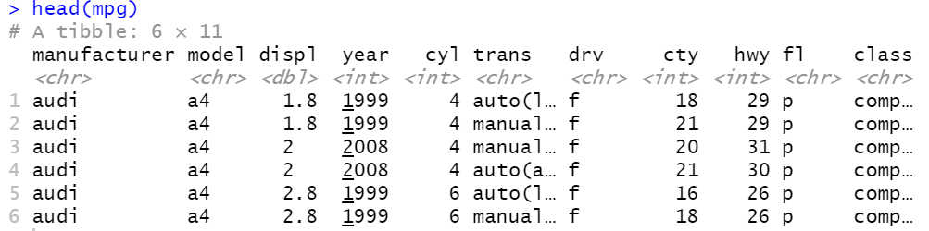
Example: mpg dataset
> data(mpg)
> colnames(mpg)
[1] "manufacturer" "model" "displ" "year"
[5] "cyl" "trans" "drv" "cty"
[9] "hwy" "fl" "class"

Slide 7
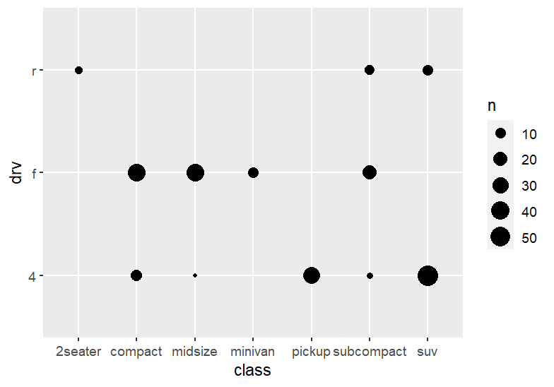
Example: mpg dataset
> ggplot(mpg, aes(x = class, y = drv)) + geom_count()

Slide 8
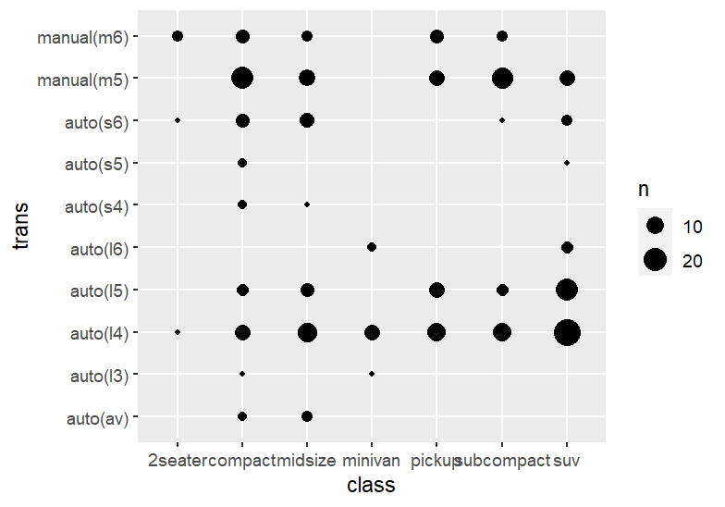
Example: mpg dataset
> ggplot(mpg, aes(x = class, y = trans)) + geom_count()

Slide 9
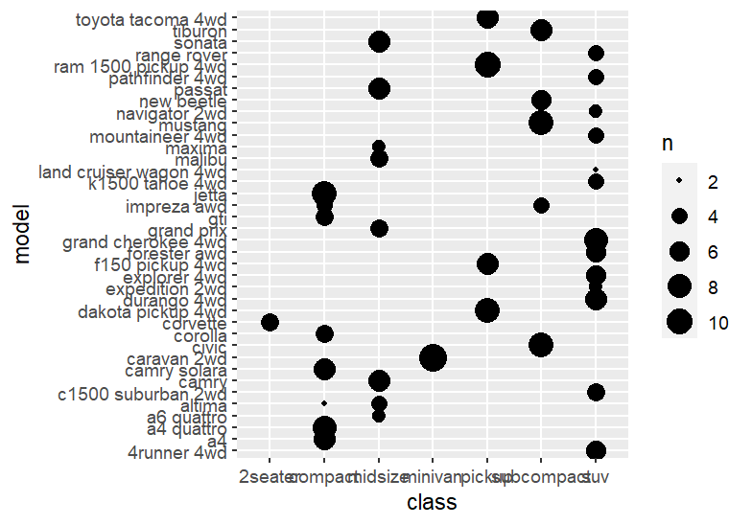
Example: mpg dataset
> ggplot(mpg, aes(x = class, y = model)) + geom_count()

Slide 10
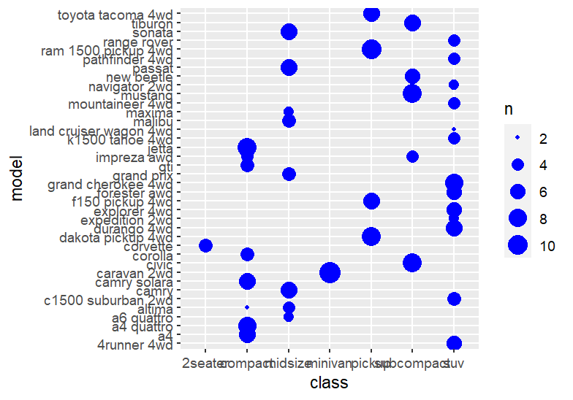
Example: mpg dataset
> ggplot(mpg, aes(x = class, y = model)) + geom_count(color=’blue’)

